Slide 1
Microsoft Azure Overview
Microsoft Research
Microsoft Azure for Research Training

Slide 2
Microsoft Azure Overview
Key learning objects for this section
Cloud computing basics
Patterns and terminology – IaaS, PaaS, and SaaS
Microsoft Azure basics
Virtual machines
Building blocks – storage
Cloud services

Slide 3
What is the cloud?
“An approach to computing that’s about internet scale and connecting to a variety of devices and endpoints.”
“Treating hardware and software resources as a utility.”
“A way to save a ton of money by only paying for what you need.”

Slide 4
On and Off
Cloud Computing Patterns
Inactivity
Period
On & off workloads (e.g. batch job)
Over provisioned capacity is wasted
Time to market can be cumbersome
Compute
t
Growing Fast
Compute
Successful services needs to grow/scale
Keeping up w/ growth is big IT challenge
Cannot provision hardware fast enough
t
Unpredictable Bursting
Compute
Unexpected/unplanned peak in demand
Sudden spike impacts performance
Can’t over provision for extreme cases
t
Predictable Bursting
Compute
Services with micro seasonality trends
Peaks due to periodic increased demand
IT complexity and wasted capacity
t
Notes:
Slide Objectives:
Describe the various computing patterns that are good for Cloud Computing
Speaking Points:
There are numerous terms and definitions floating around in the industry for “the cloud”, “cloud computing”, “cloud services”, etc.
Microsoft thinks of the cloud as simply an approach to computing that enables applications to be delivered at scale for a variety of workloads and client devices.
The cloud can help deliver IT as a standardized service…freeing you up to focus on your business
Cover the workloads in the slide

Slide 5


Cloud Computing Variants
Traditional Software
Infrastructure
(as a Service) (IaaS)
Platform
(as a Service) (Paas)
Software
(as a Service) (SaaS)
Applications
Applications
You manage
Applications
Applications
Data
You manage
Data
Data
Data
Runtime
Runtime
Runtime
Runtime
Managed by vendor
You manage
Middleware
Middleware
Middleware
Middleware
Managed by vendor
O/S
O/S
O/S
O/S
Virtualization
Virtualization
Managed by vendor
Virtualization
Virtualization
Servers
Servers
Servers
Servers
Storage
Storage
Storage
Storage
Networking
Networking
Networking
Networking
Notes:
Slide Objectives:
Explain the differences and relationship between IaaS, PaaS, and SaaS in more detail.
Speaking Points:
Here’s another way to look at the cloud services taxonomy and how this taxonomy maps to the components in an IT infrastructure.
Packaged Software
With packaged software a customer would be responsible for managing the entire stack – ranging from the network connectivity to the applications.
IaaS
With Infrastructure as a Service, the lower levels of the stack are managed by a vendor. Some of these components can be provided by traditional hosters – in fact most of them have moved to having a virtualized offering.
Very few actually provide an OS
The customer is still responsible for managing the OS through the Applications.
For the developer, an obvious benefit with IaaS is that it frees the developer from many concerns when provisioning physical or virtual machines.
This was one of the earliest and primary use cases for Amazon Web Services Elastic Cloud Compute (EC2).
Developers were able to readily provision virtual machines (AMIs) on EC2, develop and test solutions and, often, run the results ‘in production’.
The only requirement was a credit card to pay for the services.
PaaS
With Platform as a Service, everything from the network connectivity through the runtime is provided and managed by the platform vendor.
The Microsoft Azure best fits in this category today.
In fact because we don’t provide access to the underlying virtualization or operating system today, we’re often referred to as not providing IaaS.
PaaS offerings further reduce the developer burden by additionally supporting the platform runtime and related application services.
With PaaS, the developer can, almost immediately, begin creating the business logic for an application.
Potentially, the increases in productivity are considerable and, because the hardware and operational aspects of the cloud platform are also managed by the cloud platform provider, applications can quickly be taken from an idea to reality very quickly.
SaaS
Finally, with SaaS, a vendor provides the application and abstracts you from all of the underlying components.

Slide 6
Microsoft Azure LOVES EVERYONE!
Whatever client operating system you use
Whatever server operating system you want to use
100% cross platform with massive open source support

Slide 7
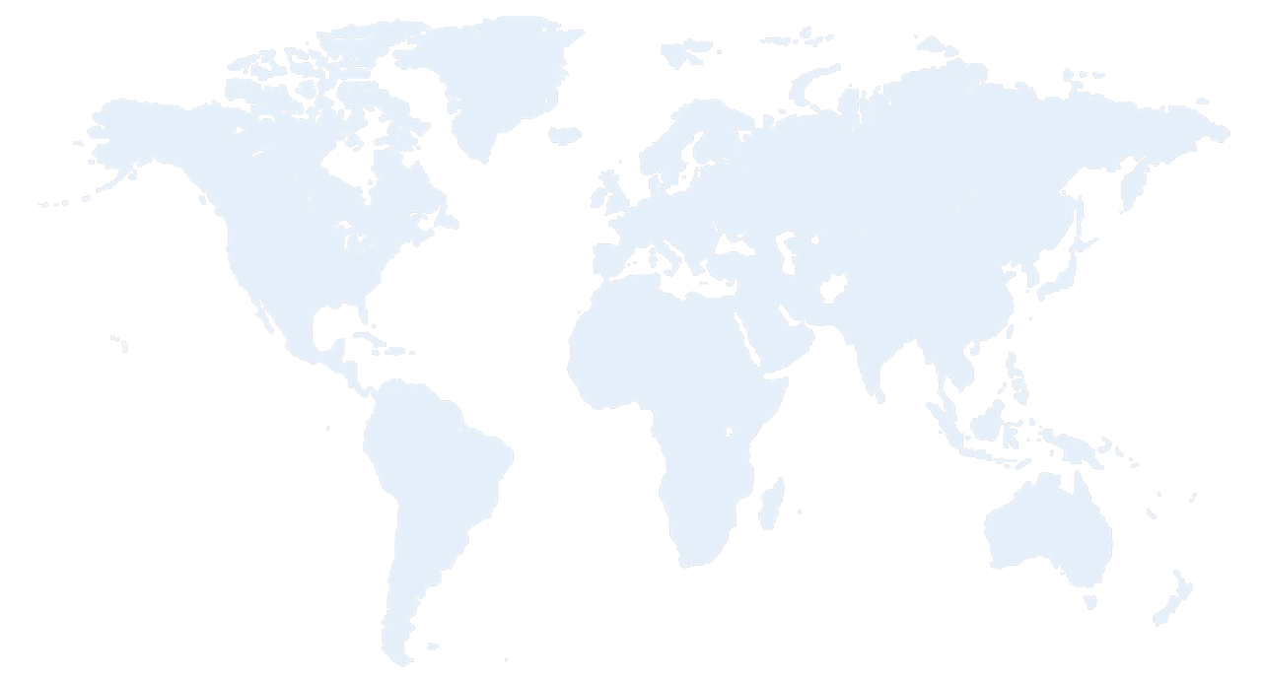


Azure Datacenter Regions
North America
Europe
Asia Pacific
N. Europe
Japan West Region
Central
N. Central
W. Europe
West US
China North
Japan East Region
East US
East US 2
S Central US
China South
E. Asia Region
S.E. Asia
Region
Brazil South
Regions
Australia
Notes:
Speaking Points:
Microsoft Azure itself is deployed around the world
With Microsoft Azure, we have a concept of regions, which is where you choose to place your code and run.
In each of the regions, we have a Microsoft datacenter.
These datacenters are massive facilities that host 14s or in some cases hundreds of thousands of servers
We have currently four regions in North America, two regions in Europe, and two in Asia
As you can see on this slide we also have a number of CDN edge points, which we can use to cache your content and deliver it even faster for customers. %
What you’re going to see in the next couple months and years is that we will rapidly expand our datacenter footprint around the world, so you will have more options for running your applications.
Once you build an application, you can choose where you want to run in the world and you can move your workloads from region to region.
You can also run your application in multiple regions simultaneously and just direct traffic and customers to whichever version of the app is closest to them.
That gives you a global footprint and a chance to reach a bigger customer base or audience in new markets
All Azure services are available in all the Azure regions at GA
AP & Cosmos are the exceptions and are in specific DCs

Slide 8
Australia
Austria
Belgium
Brazil
Canada
Chile
Colombia
Costa Rica
Cyprus
Czech Republic
Denmark
Finland
France
Germany
Greece
Hong Kong
Hungary
India
Ireland
Israel
Italy
Japan
Korea
Luxembourg
Malaysia
Mexico
Netherlands
New Zealand
Norway
Peru
Philippines
Poland
Portugal
Puerto Rico
Romania
Russia
Singapore
Spain
Sweden
Switzerland
Trinidad & Tobago
UK
United States
New Countries:
Algeria
89
countries and territories
Argentina
Belarus
Bulgaria
Croatia
Dominican Rep
Ecuador
Egypt
El Salvador
Estonia
Guatemala
Iceland
Indonesia
Jordan
Kazakhstan
Kenya
Kuwait
Latvia
Liechtenstein
Lithuania
Macedonia
Malta
Montenegro
Morocco
Azerbaijan
Nigeria
Oman
Pakistan
Panama
Paraguay
Qatar
Saudi Arabia
Serbia
Slovakia
Slovenia
South Africa
Sri Lanka
Taiwan
Thailand
Tunisia
Turkey
UAE
Ukraine
Uruguay
Venezuela
Bahrain
Notes:
Speaking Points:
Microsoft Azure is commercially available in over 89 countries and territories.
Anyone within these countries can sign up for a free trial or a paid subscription to use Microsoft Azure services
Of course you can build and deliver solutions to any of your customers worldwide.

Slide 9
>57%
Greater than
1,000,000
>250k
Fortune 500 using Azure
Active websites
SQL Databases in Azure
>20
>1
TRILLION storage objects
>300
MILLION
AD users
MILLION
Developers registered with Visual Studio Online
>2
MILLION requests/sec
>13
BILLION
authentication/wk

Slide 10
Pay only for what is used
There are zero upfront costs
For virtual machines and web sites, pay by the hour
Scale up and down your solutions as needed
Pay only for services, like Machine Learning, when calculating
Very low storage costs
Evaluation period is no cost at all – including this training

Slide 11
Microsoft Azure Services (Partial List)
Compute
Virtual Machines
Cloud Services
Batch
Web & Mobile
Web Apps
Notification Hubs
Data & Storage
DocumentDB
Redis Cache
SQL Database
Blob storage
Azure Search
Analytics
HDInsight
Machine Learning
Stream Analytics
Event Hub
Networking
VPN
Express Route
Media & CDN
Media Services
Full CDN
Identity & Access Management
Azure Active Directory

Slide 12
Microsoft Azure Portal
Life begins here: https://portal.azure.com
Individual pages are called blades

Slide 13
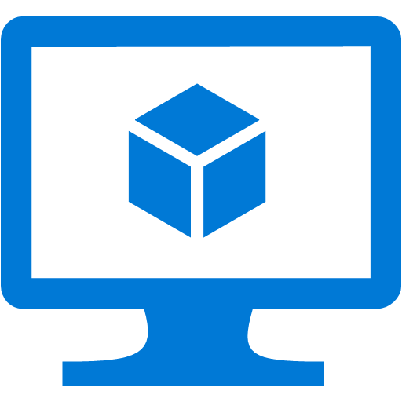
Virtual Machines
Linux and Windows Server both supported
Can use remote desktop or SSH and run any workload
You are the admin on the virtual machine
Very durable
If you reboot, all changes and data stored the disk
Virtual private networking
VMs can be grouped as part of a private network
Notes:
Transition:
For the rest of this talk I’m going to give you a tour of Microsoft Azure, walk you through many of the features, and ground you in the capabilities it provides
The first set of features I want to walk through is Virtual Machines.
Speaking Points:
If you’re familiar with traditional hosting, this is probably the feature that feels most familiar and consistent with what other hosting providers provide.
The ability to stand up a virtual machine with either Windows or Linux that you can basically remote desktop in or SSH in and run any workload.
These virtual machines enable you to be admin on the box
They are durable, meaning if you reboot the VM, it is still there with all of your changes and data you stored to disk
This means you can run any type of workload
If you want to run SQL you can, if you want to install a no-SQL solution, you can do that to.
If you want to run SharePoint you can do that.
Provides ultimate flexibility to do what you want to do
Also enables you to do what we call virtual private networking
With virtual private networking, you can deploy Virtual Machines in the cloud and group them together so they are part of their own private network
You can also then connect it back to your corporate network (if you have one) and establish a VPN secure tunnel to link your machines running in your own corporate environment up to your virtual machines in the cloud – making them look like they’re all part of one connected network.
So lots of flexibility in the compute side as well as in the networking side.

Slide 14






VM with persistent storage
VMs have drives backed by Microsoft Azure storage
Mounted drives are triply replicated
If one goes bad, automatically usesreplicas
VM never know an issue occurred
Microsoft Azure Storage

Slide 15
Continuous storage geo-replication
You save something in the storage system
In background automatically replicated to another datacenter
Can turn this off if you want
WEST DC
EAST DC

Slide 16

Web sites
Don’t worry or thing about VMs, servers, or infrastructure
Can build with .NET, Java, Node.js, PHP, or Python
Deploy in seconds with VSO/Git/FTP/Mercurial/Dropbox
Start for free, scale up as your traffic grows
Any tool and Linux, OS X, or Windows to build
Web instances can be registered with load balancers, CDN, etc.
Notes:
Speaking Points:
Transition
Virtual machines provide a very flexible compute model.
Another compute service available in Microsoft Azure is called Microsoft Azure Web Sites.
Definition:
Microsoft Azure Web Sites there is a managed service that you can use to run web sites and web APIs.
Enable you to quickly stand up web applications and web sites on the internet
Auto-managed environment
Just say that you want a web, here’s the DNS, copy the content, and we do the rest
You don’t have to worry or think about VMs, servers, or infrastructure.
You can simply focus on building and deploying HTTP based applications.
Enables you to build web sites using ASP.NET, Node.js, PHP, and now with an update a few weeks ago – Python
Allows you to use any tool and any operating system to build these sites including Windows, OS X, and Linux.
Enables a very fast deployment model. You can literally deploy in seconds.
You can easily deploy these sites using the tools and infrastructure you know.
We support several flexible deployment options including FTP, GIT, and Team Foundation Services
What is nice about this offering is that not only does it enable to very quickly get going, but it also allows you to start with a free offer in a shared environment.
Pricing starts at free.. Perpetually free and then you can scale up as you need more capability
You can then scale up these sites using reserved instances for higher performance and isolation and scale out these sites as your web site becomes successful and you have increased load.
Deployment with:
Cloud-hosted source control system: Visual Studio Online, Git, Mercurial, Dropbox
IDE: Visual Studio, WebMatrix
FTP
On-premise source control system: VSO, on premise Git or Mercurial repositories
Command Line tools and REST API: MSBuild, FTP scripts, PowerShell, .NET Management API, Cross-platform command line(xpat-cli), Web Deploy command line

Slide 17
Microsoft Azure Services
The parts of Azure you care about as a researcher!
Storage
Machine Learning
Stream Analytics
HDInsight (Hadoop, Spark)
High Performance Computing
Each of these have upcoming hands-on labs

Slide 18
Hands-On Lab!
Creating Your Free Accounts
Introduction Creating Accounts HOL

